Slide 1



From annular cavity to rotor-stator flow: nonlinear dynamics of axisymmetric rolls
Artur Gesla ^{1,2,*}
Patrick Le Quéré ²
Yohann Duguet ²
Laurent Martin Witkowski ³
¹ Sorbonne Université
² Université Paris-Saclay, LISN-CNRS
³ Université Claude Bernard Lyon 1, LMFA
* now at EPFL, group HEAD with Eunok Yim

Slide 2
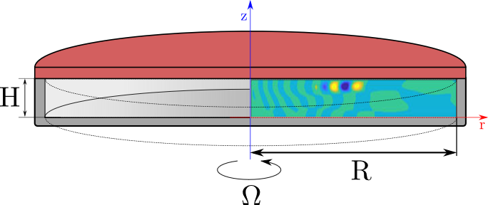
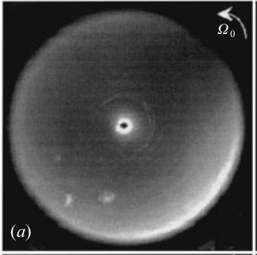
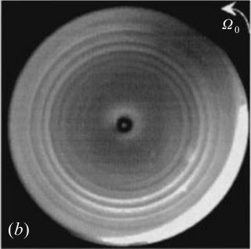
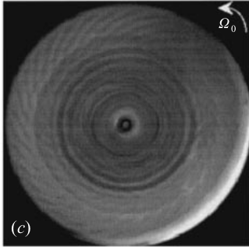
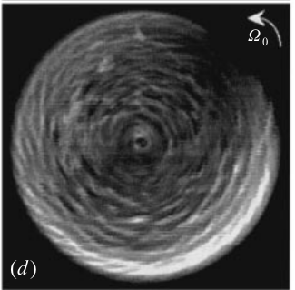
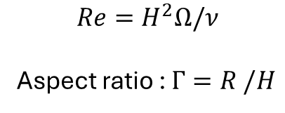
$$Re=H^{2}Ω/ν$$
Aspect ratio : $Γ=R /H$
Circular rolls
Circular + spiral rolls
Re=150
Re=500
Re=700
Re=1200
Re
Gauthier et al., 1999

Slide 3
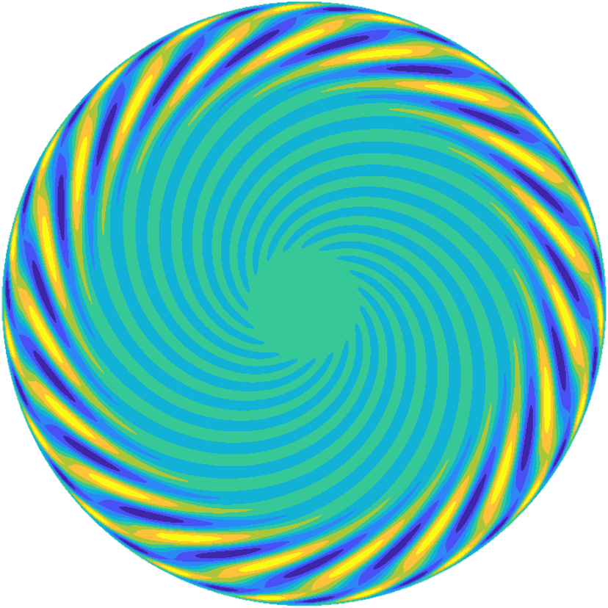
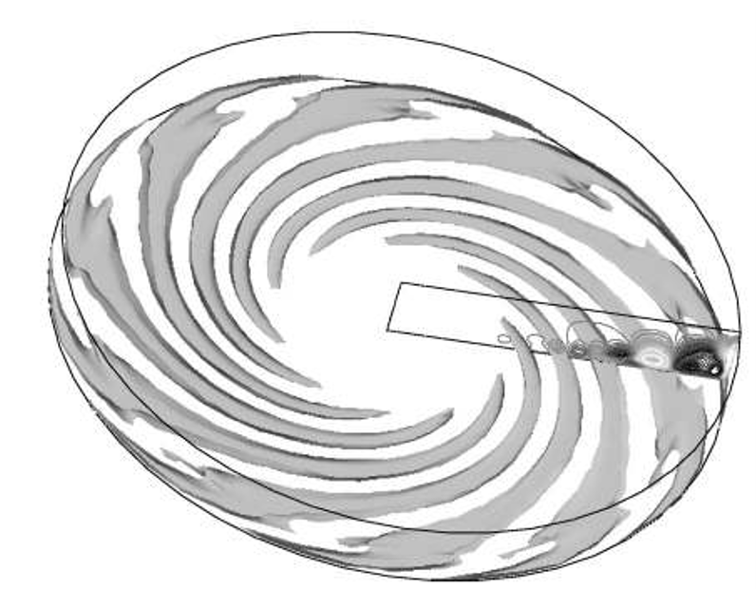
Circular rolls
Circular + spiral rolls
First linearly unstable mode, R/H=10
Gauthier et al., 1999
Saturated state, DNS, R/H=5
Gelfgat, Fluid Dyn. Res. 2015
Serre et al., PoF 2004
Challenge: No clear explanation for the circular rolls.

Slide 4
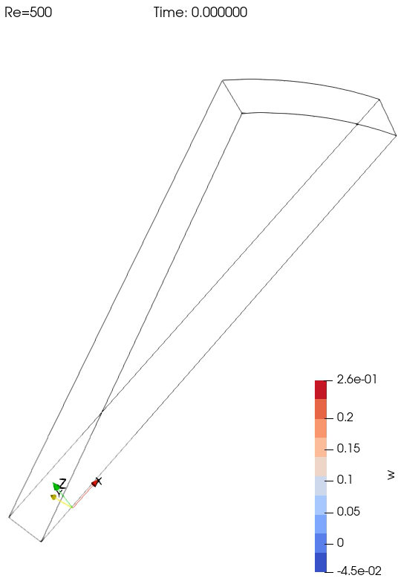

Experiment
Experiment
DNS
DNS

Slide 5
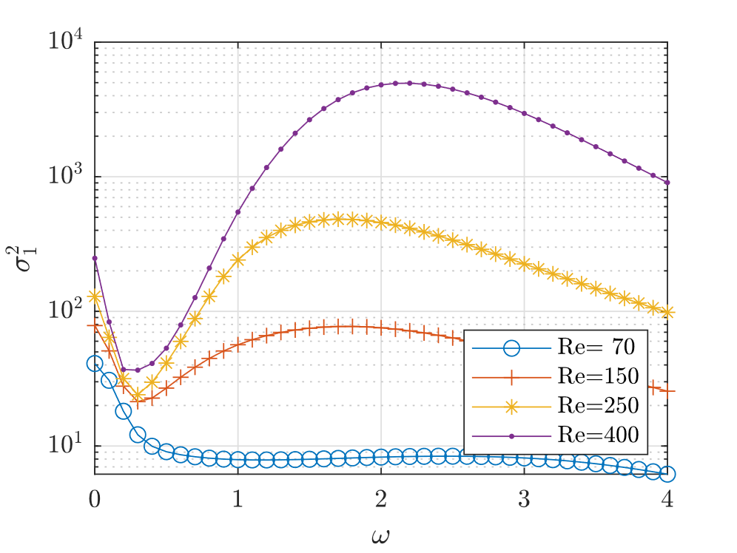

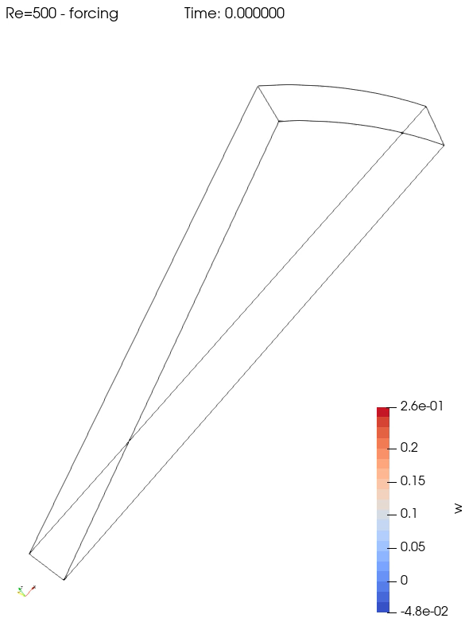
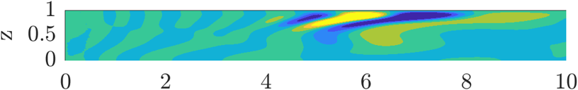
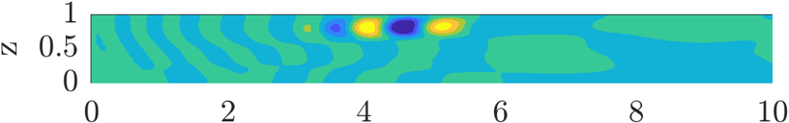
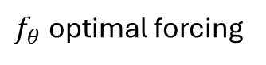
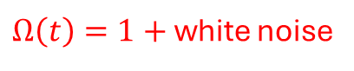
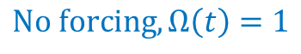
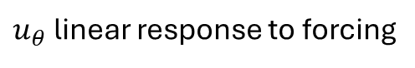
Experiment
Resolvent analysis (axisymmetric)
Circular rolls seen experimentally are a linear response to forcing.
Optimal gain
$$No forcing, Ω\left(t\right)=1$$
$Ω\left(t\right)=1+$ white noise
$f_{θ}$ optimal forcing
$u_{θ}$ linear response to forcing
Gesla et al. On the origin of circular rolls in rotor-stator flow, JFM 2024.

Slide 6
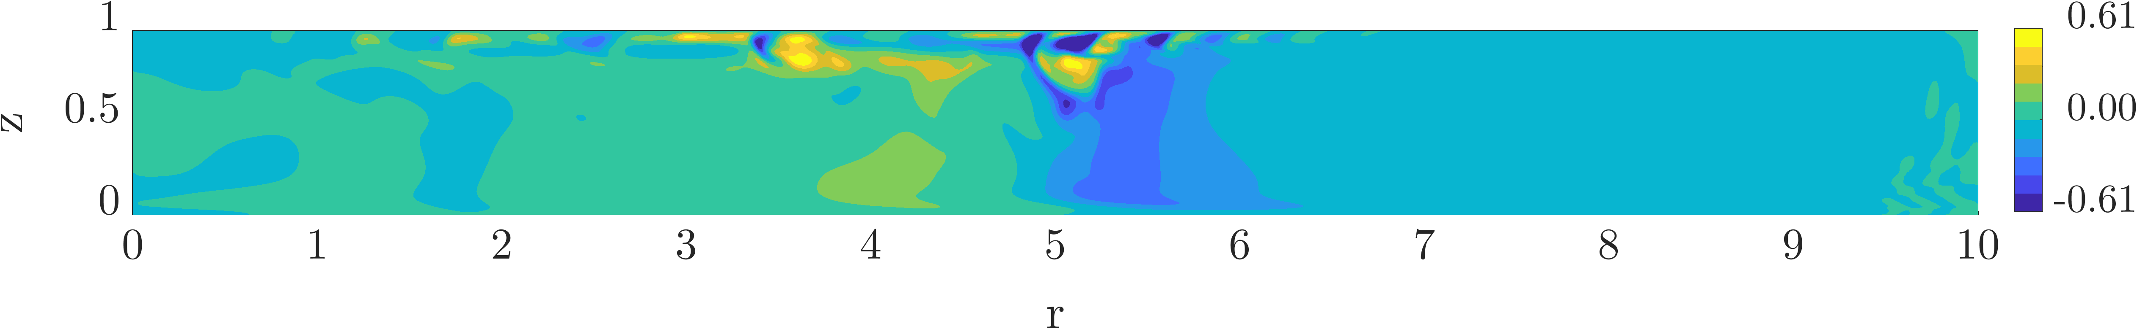
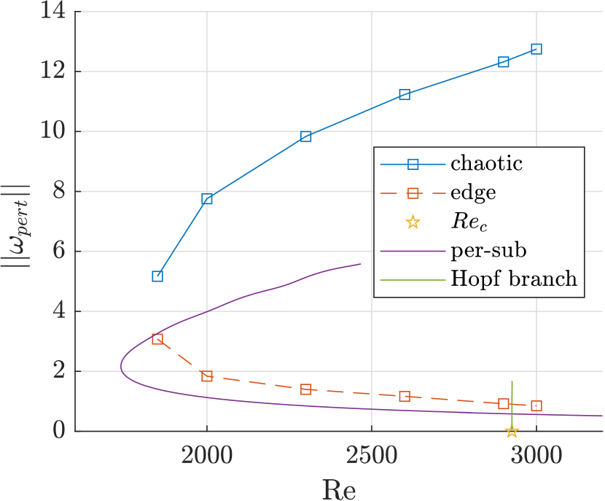
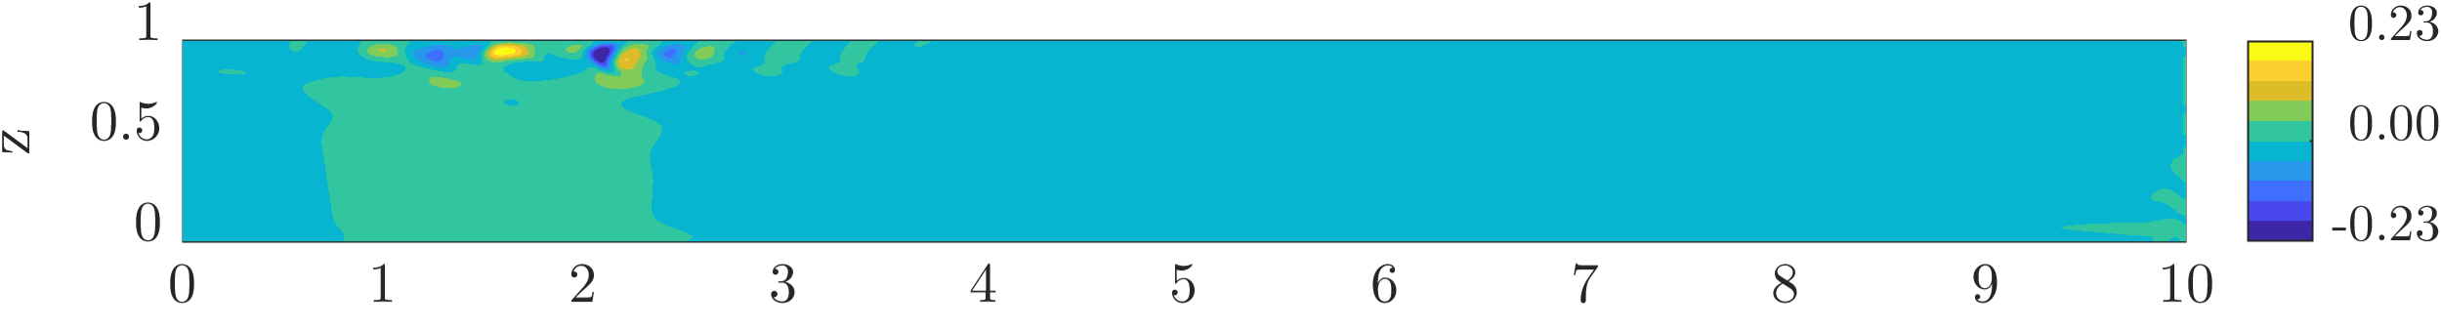
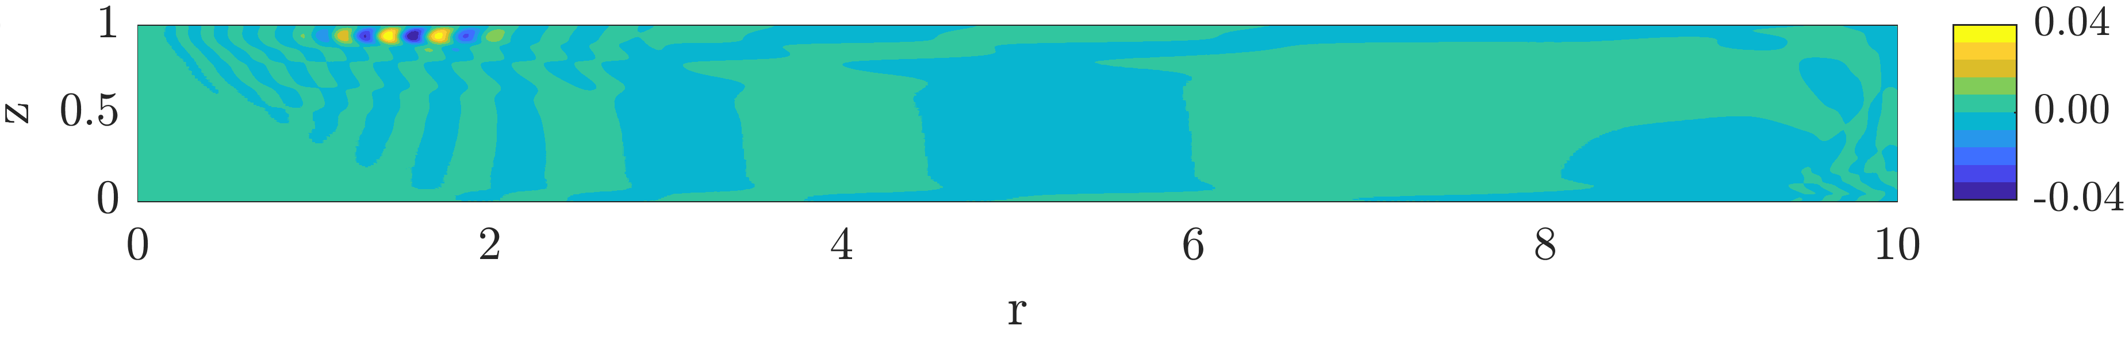
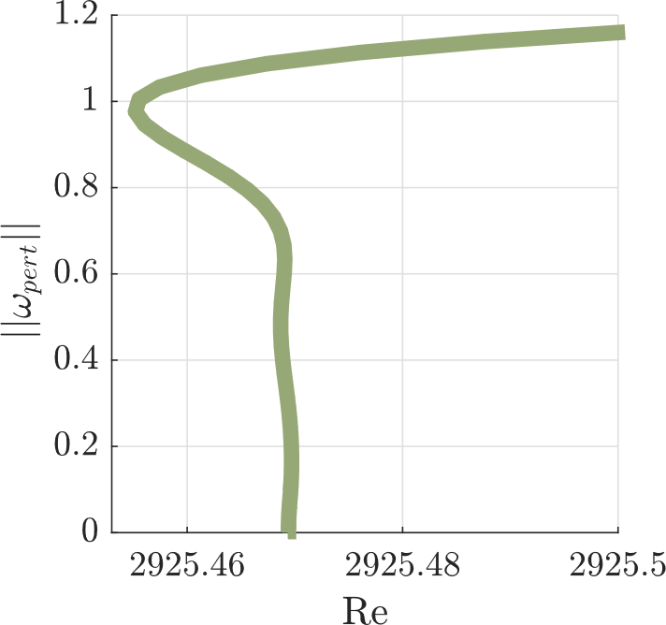
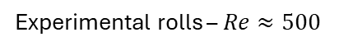
Self-sustained axisymmetric solutions
Gesla et al. Subcritical axisymmetric solutions in rotor-stator flow, PRF 2024.
Chaotic state
Biperiodic edge state
Periodic-subcritical branch
Experimental rolls – $Re≈500$
Linear instability (axisym.)

Slide 7
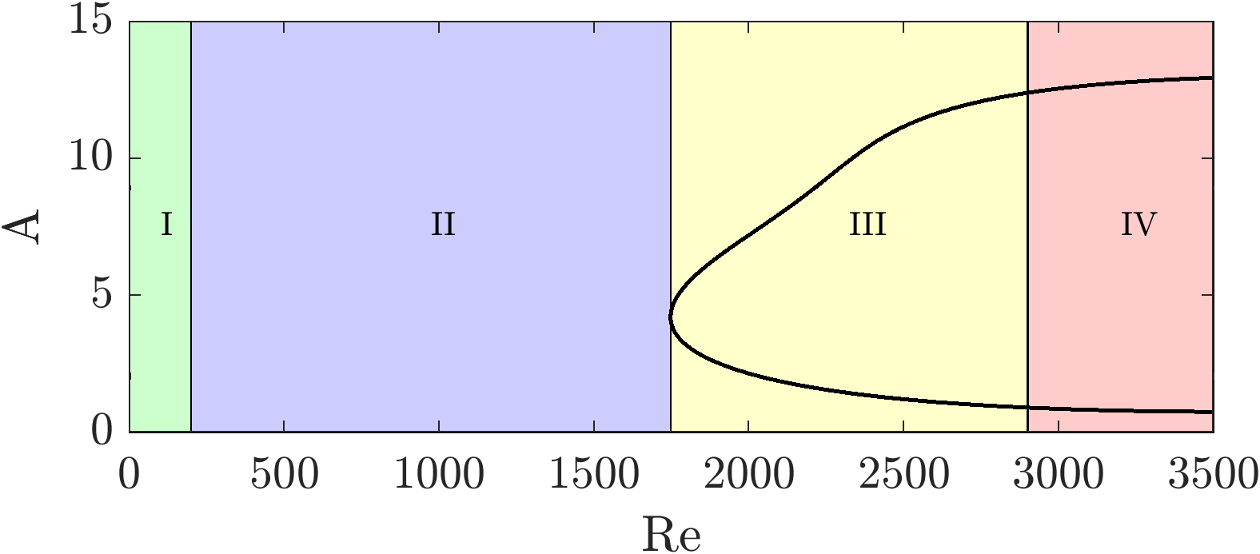
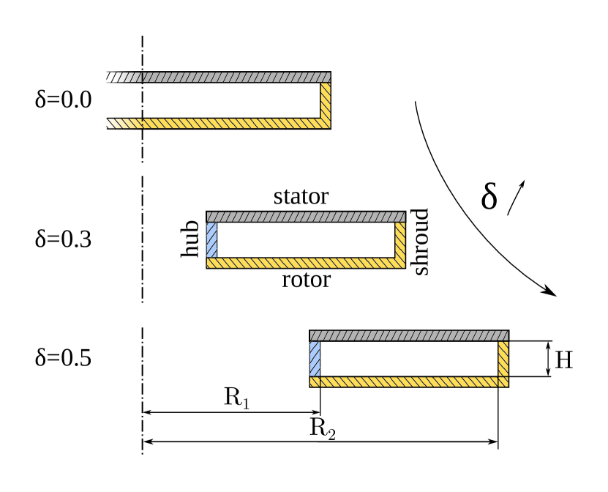
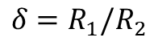
Finite lifetimes
Dynamics of circular rolls
Use homotopy to explain the origin of the self-sustained states.
Stable flow, no rolls
Lin. stable flow, self-sustained solutions exist
Stable flow, circular rolls appear as a response to forcing
Unstable flow, evolution to chaotic dynamics
$$δ=R_{1}/R_{2}$$
Re=200
Re=3000

Slide 8
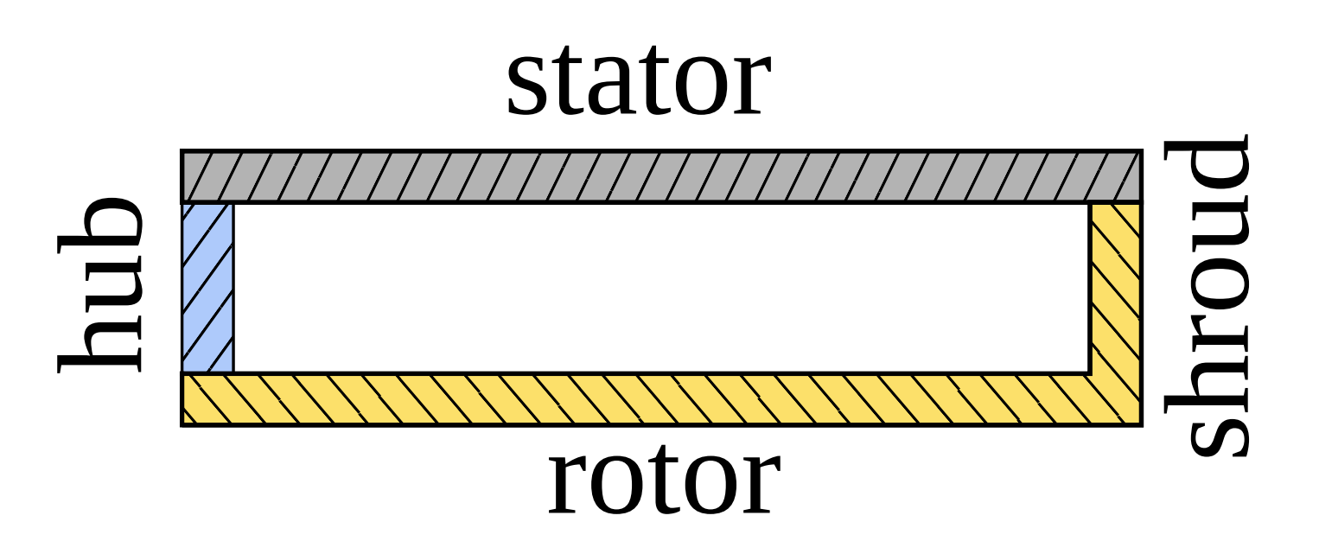
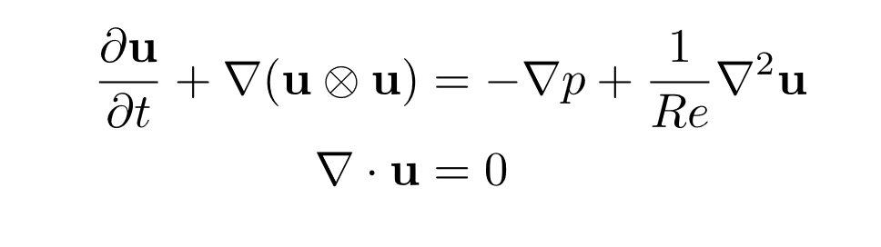
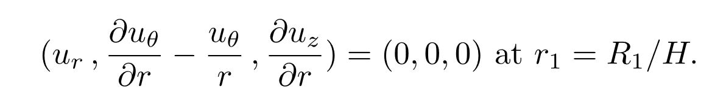
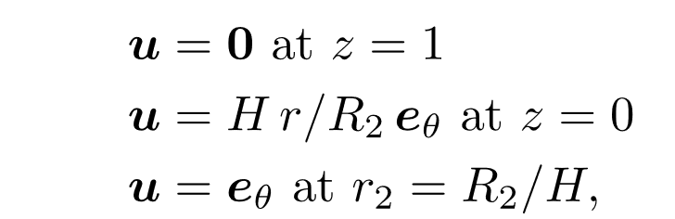
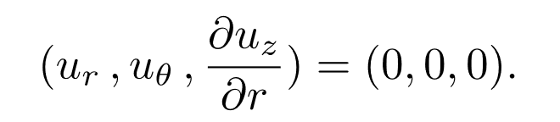
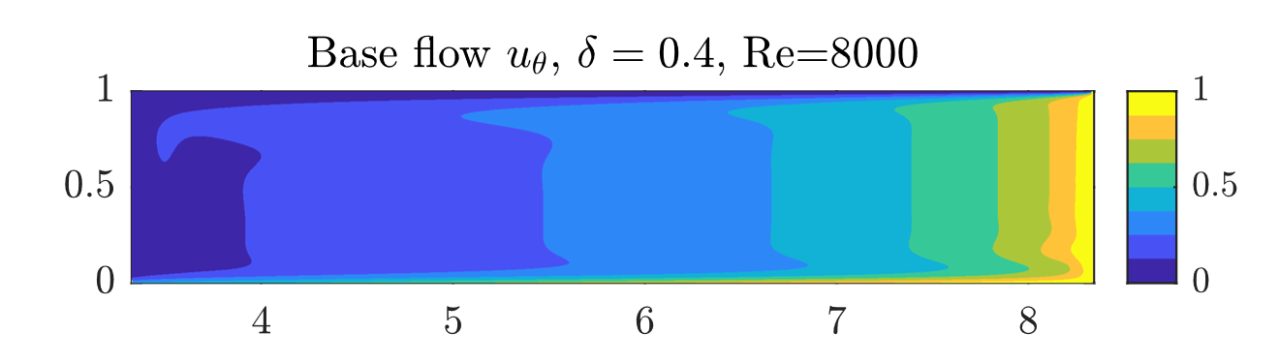
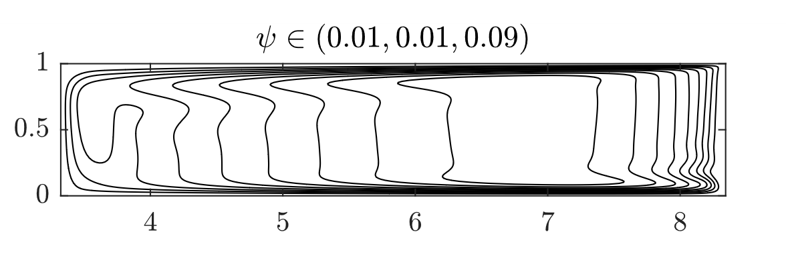

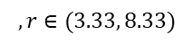
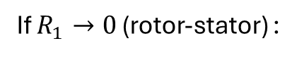
z
r
Aspect ratio R/H=5
Boundary conditions :
Stress-free on the hub :
stator,
rotor,
If $R_{1}→0$ (rotor-stator) :
shroud.
Numerical methods:
Finite Volume discretization r-z
Steady state - Newton method + continuation
Stability – eigenvalue solver (ARPACK)
Time integration with BDF2 scheme
Bisection
$$,r∈(3.33, 8.33)$$

Slide 9
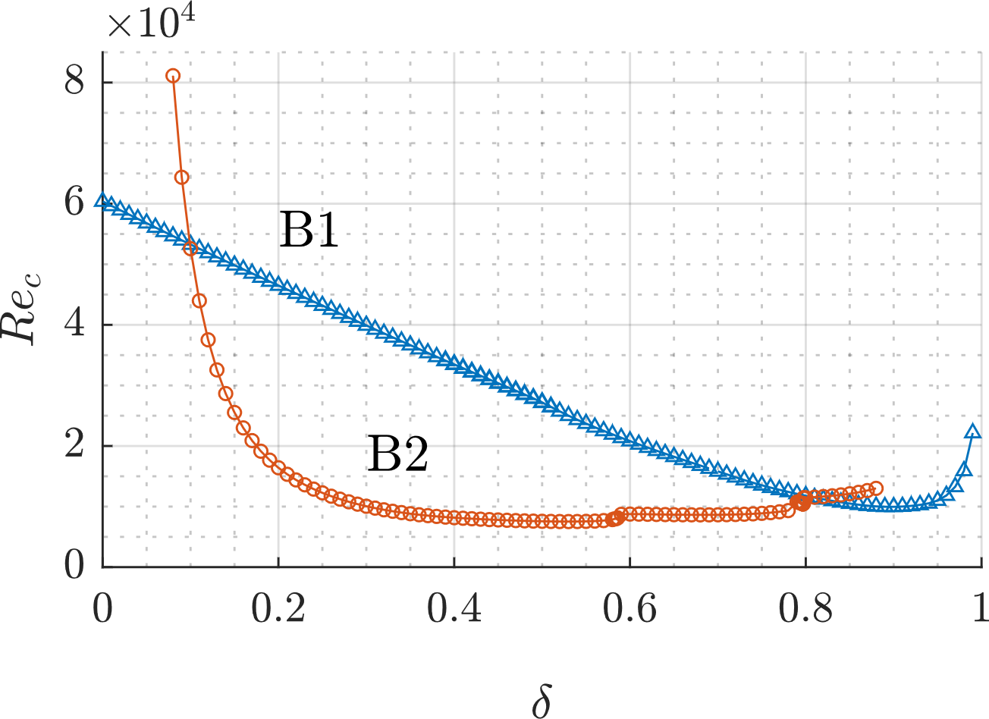

Slide 10
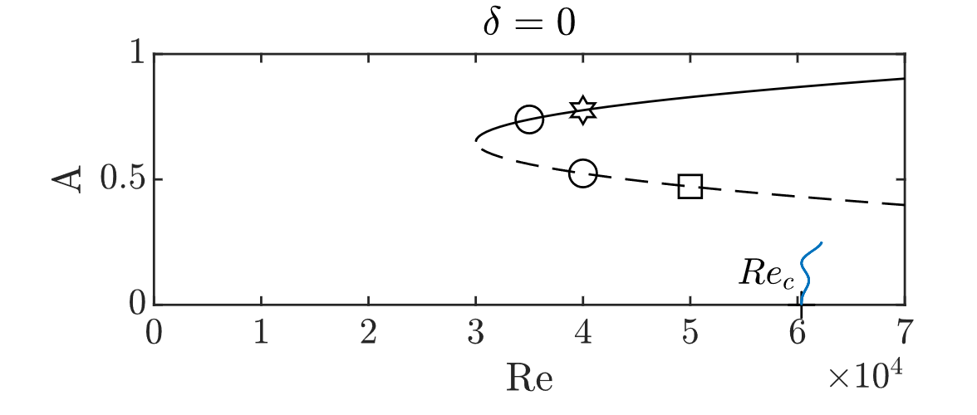
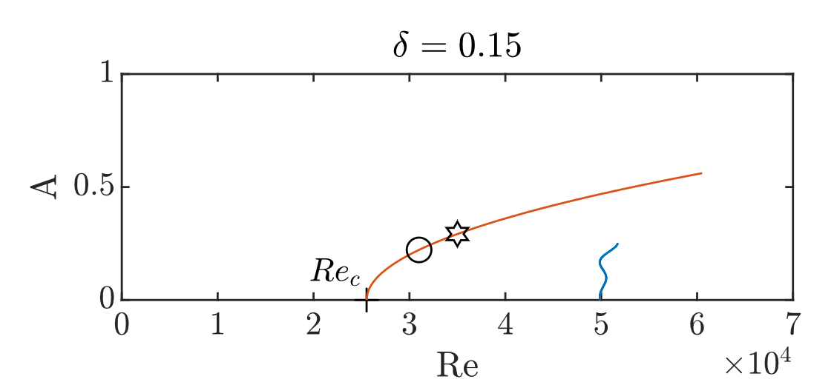
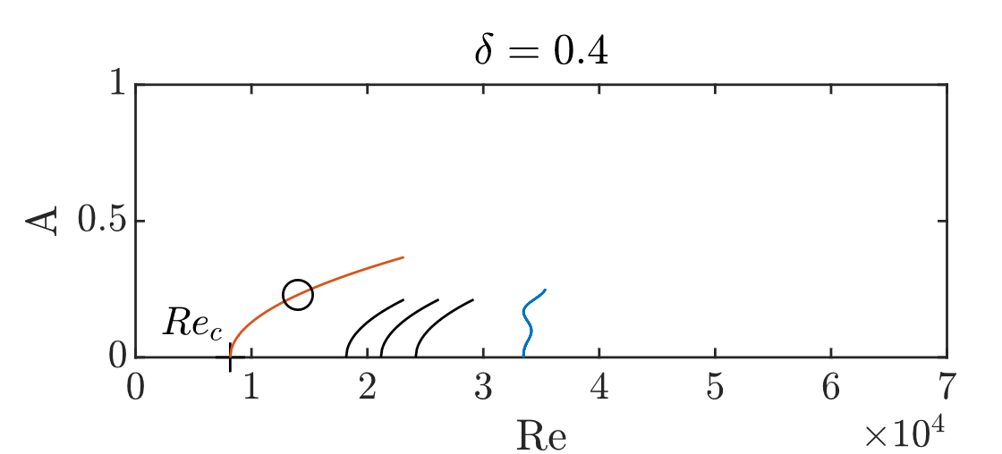
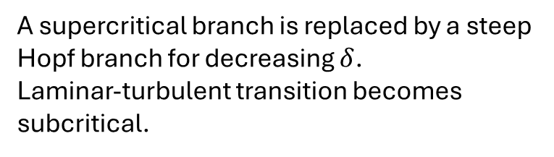
Exchange of stability
A supercritical branch is replaced by a steep Hopf branch for decreasing $δ$.
Laminar-turbulent transition becomes subcritical.

Slide 11
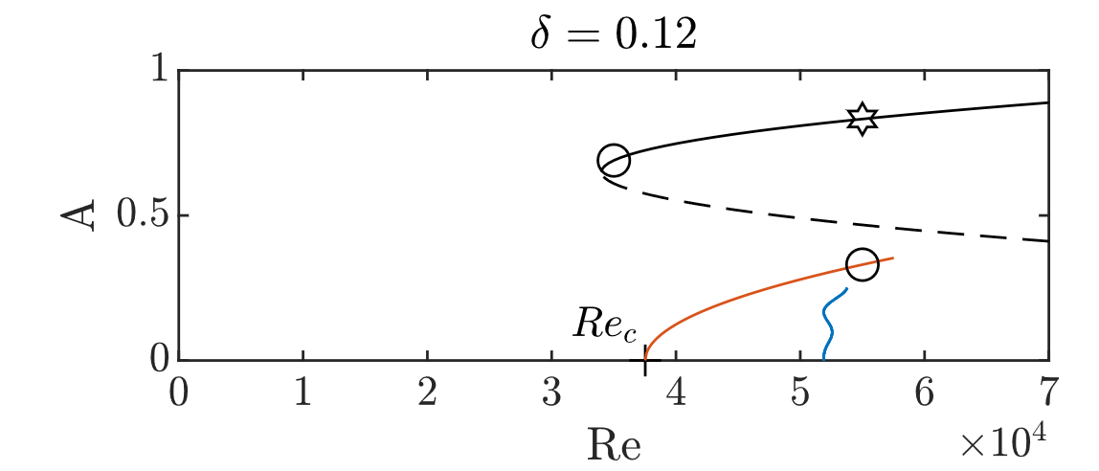
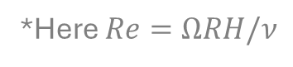
Supercritical transition
◦ – periodic state
3.33
8.33
Supercritical transition
◦ – periodic state
✶ - chaotic state
0.88
5.88
Competition between
branches
◦ – periodic state
✶ - chaotic state
0.68
5.68
Subcritical transition
◦ – periodic state
□ - biperiodic state
✶ - chaotic state
*Here $Re=ΩRH/ν$

Slide 12
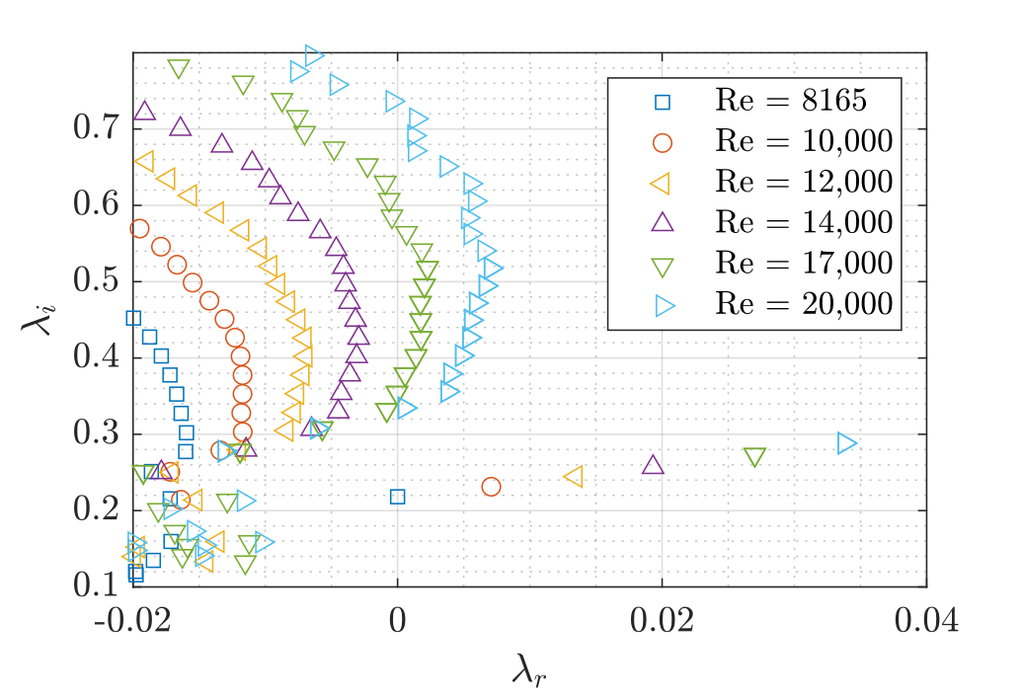
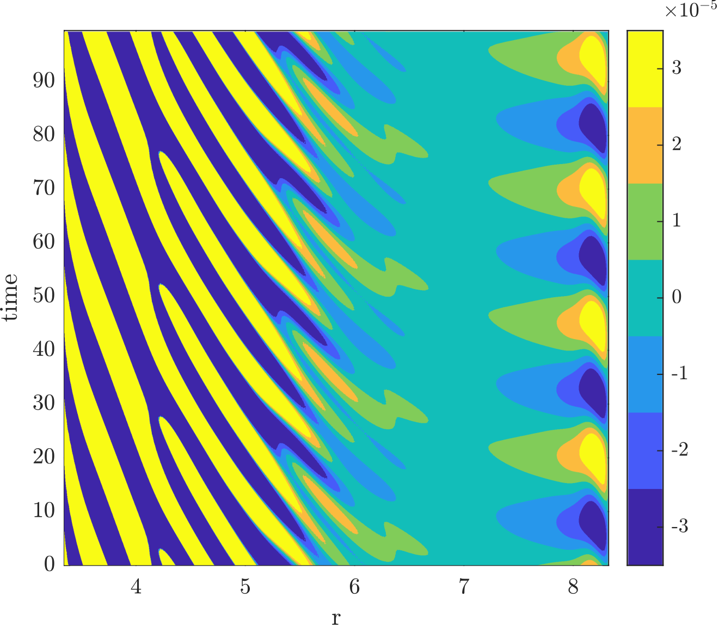
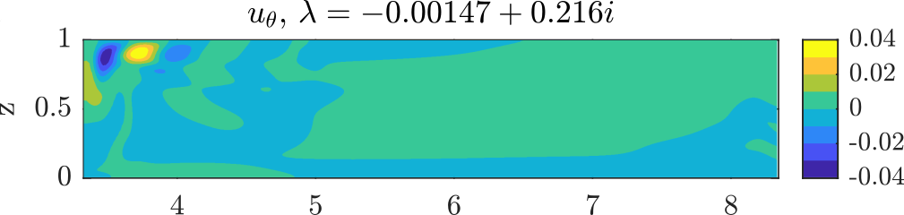
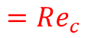
$$=Re_{c}$$
○ – periodic state
Periodic state on a supercritical branch
Roll pairing

Slide 13
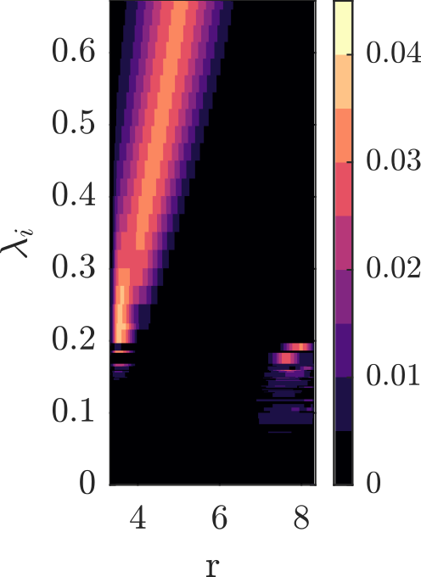
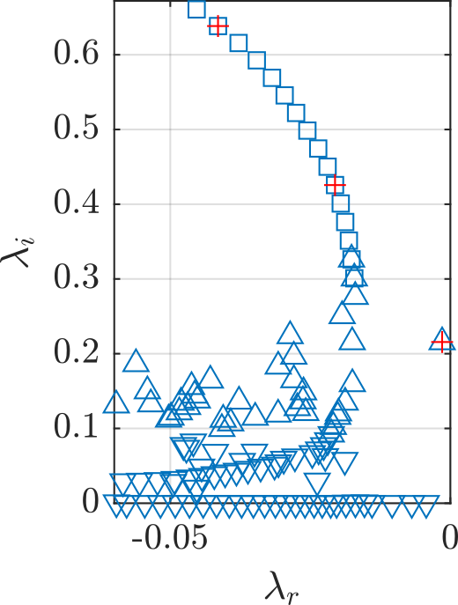
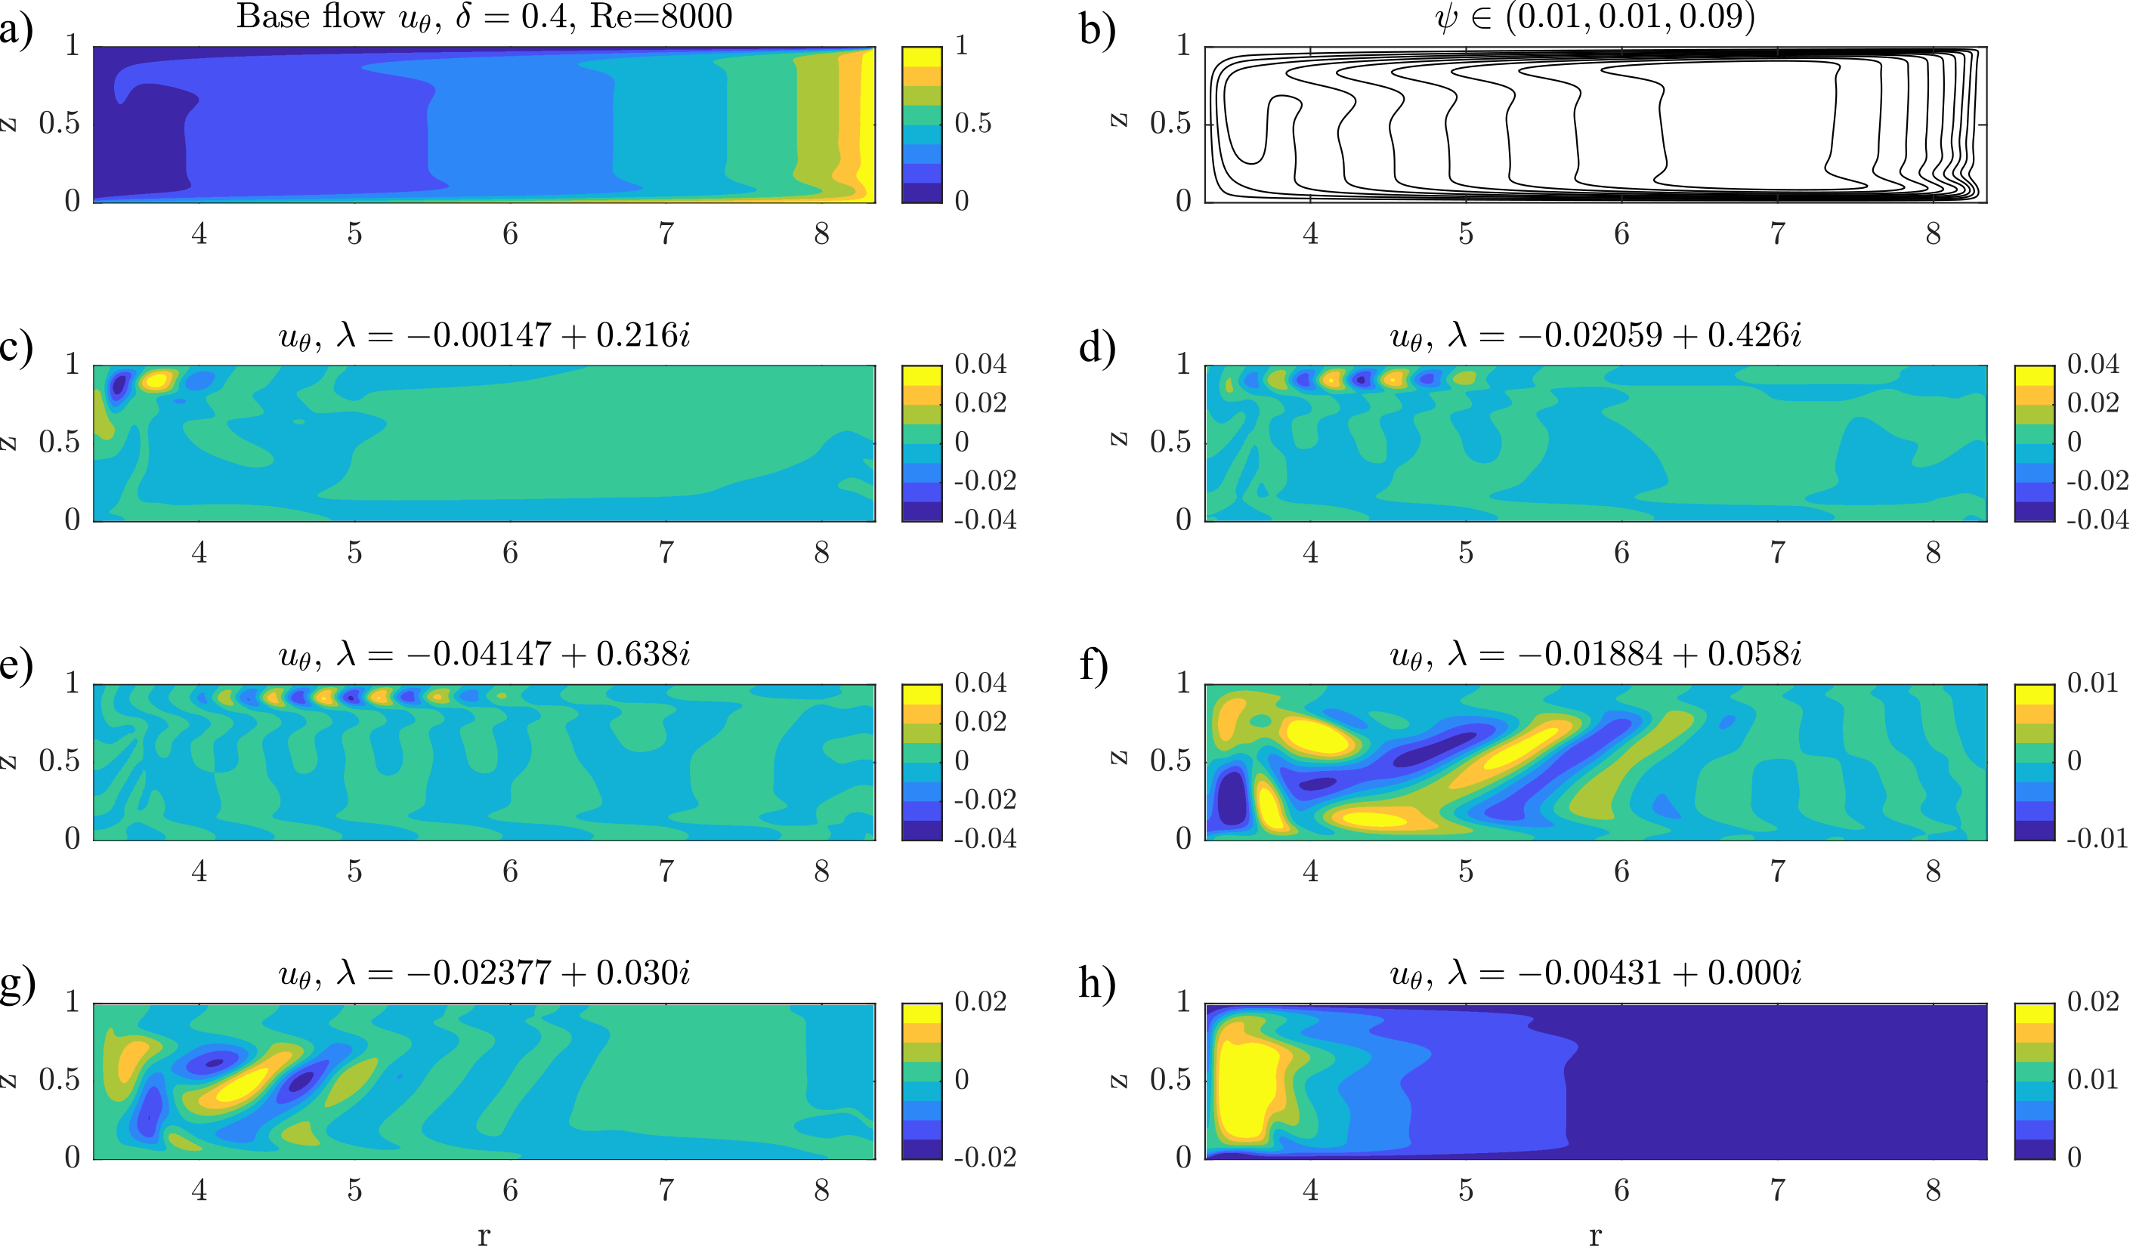
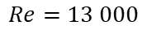

Pairing scenario
$$Re=13 000$$
○ – periodic state
Eigenvector magnitude
$$Re=8 000$$

Slide 14



Merging scenario
$$Re=8 000$$
$$u∝e^{λt}$$
Roll merging
Interaction of $λ_{i}=0.216i$ with itself forces the $λ_{i}=0.426i$
Interaction of these two forces the $λ_{i}=0.638i$
Different spatial support, phase velocity and number of rolls appears as merging

Slide 15




Re = 55 000
◦ – periodic state
✶ - chaotic state

Slide 16






Periodic top branch
Chaotic top branch
Subcritical transition
◦ – periodic state
□ - biperiodic state
✶ - chaotic state

Slide 17



Summary
Chaotic state
Self-sustained states
Experimental rolls – $Re≈500$
$u_{θ}$ optimal response
Gesla et al. Subcritical axisymmetric solutions in rotor-stator flow, PRF 2024.
Gesla et al. From annular cavity to rotor-stator flow: nonlinear dynamics of axisymmetric rolls, to appear in PRF 2025.
Gesla et al. On the origin of circular rolls in rotor-stator flow, JFM 2024.

Slide 18




Summary:
Outlooks:
Role of periodic states in edge state/ top branch dynamics (Harmonic Balance Method, Floquet Analysis)
Stability exchange for a radially displaced cavity.
cold
adiabatic
hot
hot
New perspective on the roll merging.
$δ→1$ analysis, similarity to a Differentially Heated Cavity for $Pr=1$and $ΔΩ≪Ω$, comparison of thresholds in Ra and Re
Gesla et al. From annular cavity to rotor-stator flow: nonlinear dynamics of axisymmetric rolls, accepted PRF 2025.

Slide 20



Critical Re
Boundary layer mode
Corner mode
B1
B2
B1
Branch B1 is responsible for the linear instability at $δ<0.1$ and $δ>0.8$.
Eigenmode changes continuously from a boundary layer structure to a corner structure.

Slide 21





Corner singularity

Slide 22

Exchange of stability
A supercritical branch is replaced by a steep Hopf branch for decreasing $δ$.
Laminar-turbulent transition becomes subcritical.

